Slide 1
SHALLOW FOUNDATION
Foundation is shallow if its depth is equal to or less than its width.
Types of shallow foundation
Spread footings
Combined footings
Strap or cantilever footings
Mat or raft foundation

Slide 2
1. Spread footings
Spreads the super-imposed load of a wall or a column over a larger area.
Used where the loads are light or there are strong shallow soils.
Spread footing may be of the following types –
Single column footing
Stepped column footing
Slopped column footing
Simple Wall footing
Stepped wall footing
Grillage foundation
Pad footing
strip footing

Slide 3
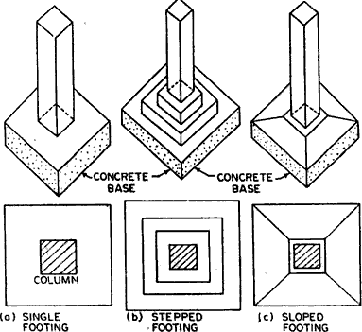

Slide 4
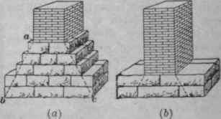
a)Stepped wall footing
b)Simple Wall footing

Slide 5
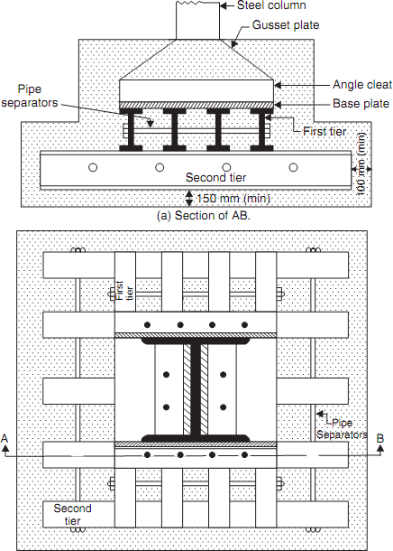
Grillage foundation

Slide 6
2. Combined footings
Are preferred when 2 individual column are close to each other.
It is economical.
Provided when bearing capacity of soil is less, requiring more area under individual footing.
Combined footing may be rectangular, Trapezoidal or column-wall.
If the columns carry equal loads, the footing is of rectangular shape, otherwise its trapezoidal shape.

Slide 7
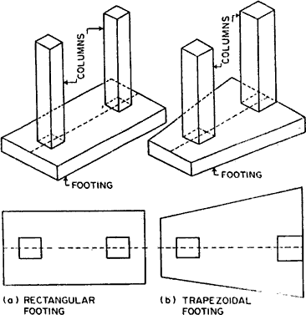

Slide 8
3. Strap or cantilever footings
Independent footings of two columns are connected by a beam.
The strap beam does not remain in contact with soil, and thus does not transfer any pressure to the soil.

Slide 9
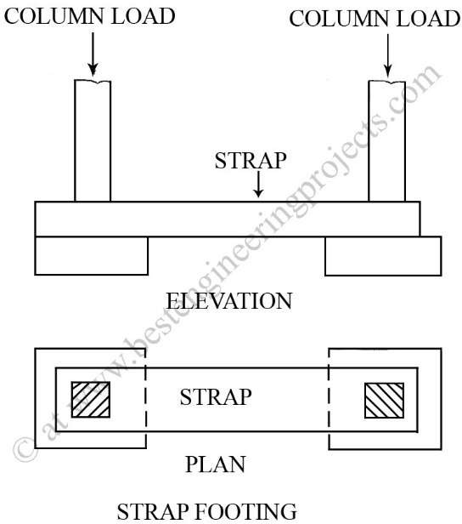

Slide 10
4. Mat or raft foundation
It is a combined footing that covers the entire area beneath a structure and supports all the walls and columns.
Used on soft or loose soils with low bearing capacity as they can spread loads over larger area.

Slide 11
